Slide 1
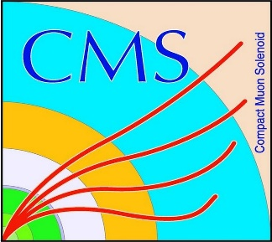

HEP Weekly Report
George Bakas
NTUA

Slide 2
Progress Report
DCS
fwInstallationUtils
Final Testing for new dbEditorAndNavigator
CMSfwInstallUtils
Re-implementation of the confDb checks between database and project
Analysis
Deep AK8 top tagger
Tried to implement the top tagger in our analysis with Lisa and Giannis
Problems in implementation, contacted people responsible for Tagger
Finally DeepAK8 was implemented
Top-Antitop Angular Distributions
Production with 2016 and 2017 MC for Zprime to Ttbar
Encountered problems with MC’s because some variables were not there
Had to use the Fall17 samples (recommended from the PPD)
Idea is with to calculate not mTTbarParton Distribution (usual)
Angular distribution from top/antitop (boosted in the Zero mass frame) for different parts of the mTTbarParton phase space
cos(theta) for [800-1000], [1000-1200], [1200-1500], [1500-2000], [2000-2500], [2500-3000]
What you will see here is with 2016 MC (rereco) , not many events ~60K

Slide 3
Selection
Reco:
nJets > 1,
|jetEta| < 2.4 (both jets)
jetPt > 400 GeV (both jets)
120 GeV < jetMassSoftDrop < 200 GeV (both jets)
Parton:
|etaParton| < 2.4 (both partons)
ptTopParton > 400 GeV (both partons)
mTTbarParton > 800
Both jets pass our top tagger (top tagger mva > 0.3)
Both jets should be btagged (medium WP)
Questions:
Should we do the training again with the 2017 MC?

Slide 4
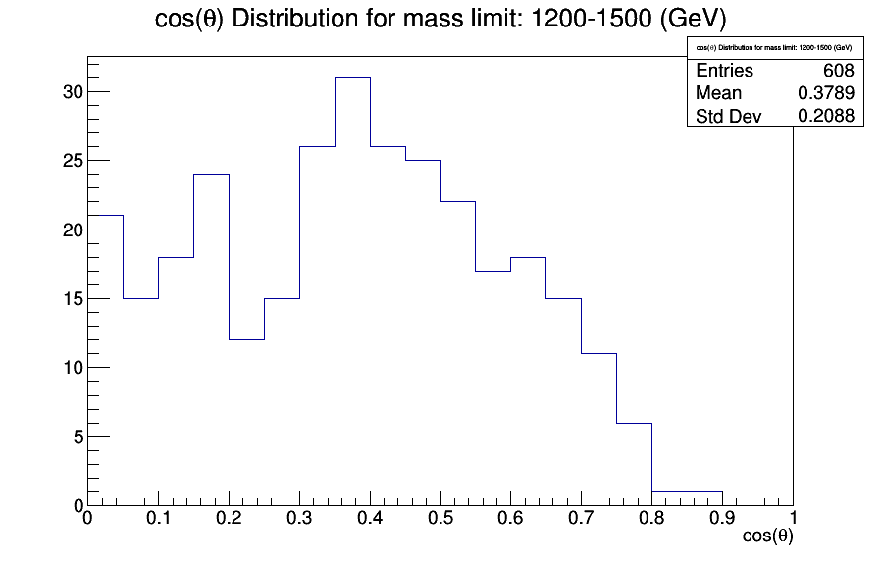

Slide 5
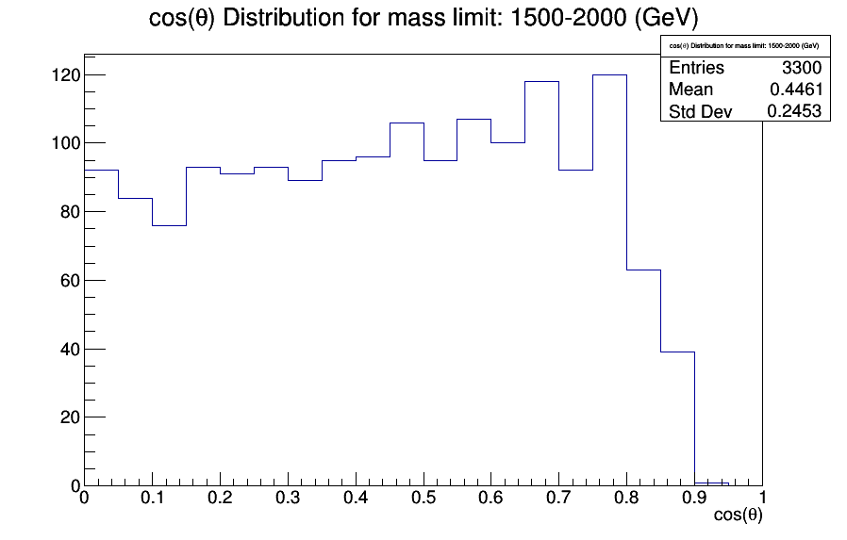

Slide 6
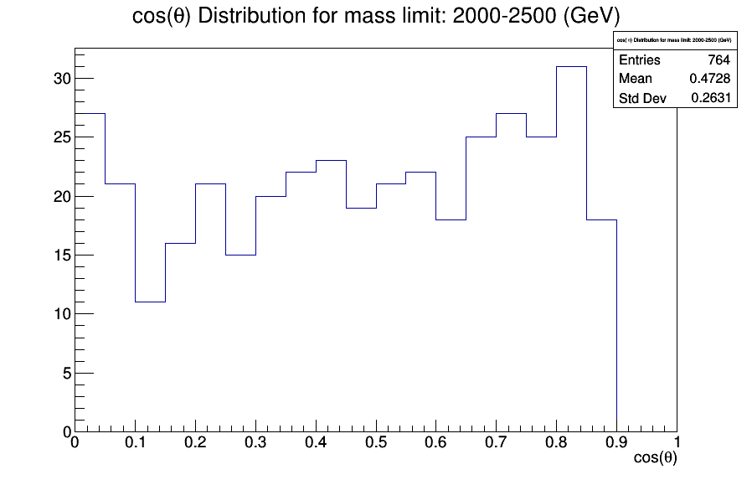

Slide 7
